Slide 1
AI Booking Assistant
Intelligent Conversational Platform for Service Reservations
HANS RAJ • 2022BCE07AED190 • Alliance University

Slide 2
Use Case Overview
Problem: Manual booking processes are time-consuming & error-prone
Solution: AI chatbot automates service bookings (hotels, doctors, restaurants, spas)
Target Users: Customers, service providers, admins
Key Benefits: 24/7 availability, instant confirmations, multi-language support

Slide 3
Solution Overview
AI Chatbot: Conversational interface with intent detection & entity extraction
RAG Pipeline: Retrieval-Augmented Generation for intelligent responses
Booking Engine: Step-by-step form validation (name, email, phone, date, time)
Email Notifications: SendGrid integration for confirmations

Slide 4
🛠️ Tech Stack & Approach
Frontend
AI/LLM
Streamlit (Python)
Groq API (Fast Inference)
Backend
Email
Python, LangChain
SendGrid Integration
Database
Supabase (PostgreSQL)
Deployment
Docker + Cloud

Slide 5
System Architecture
User Input
↓ (Streamlit Chat UI)
Intent Detection & RAG Pipeline
↓ (Groq LLM + Vector DB)
Booking Flow Engine
↓ (Form Validation + Groq LLM )
Database & Email
Supabase + SendGrid → Confirmation

Slide 6
Booking Flow (5-Step Process)
Step 1 – Greeting / Intent Detection Detects "hi", "book hotel", or PDF queriesResponds with greeting or RAG answer
Step 2 – Entity Collection Extracts info via LLM: name, email, phone, booking type Prompts only for missing fields
Step 3 – Date & Time Collects date and time if not already provided
Step 4 – Review Shows booking summary Asks for confirmation
Step 5 – Confirmation Saves to DB, sends email, generates Booking ID Resets session for next booking

Slide 7
RAG (Retrieval-Augmented Generation) Design
Vector Store: Embedded service descriptions, pricing, availability
Query Processing: User question → similarity search → relevant docs retrieved
LLM Response: Context-aware answers about services
Fallback: Safe graceful degradation if RAG unavailable

Slide 8
Admin Dashboard Features
Bookings View: All customer bookings with status (pending, confirmed, completed)
Customer Analytics: Total bookings, service breakdown, revenue tracking
Export Reports: CSV download for business intelligence

Slide 9
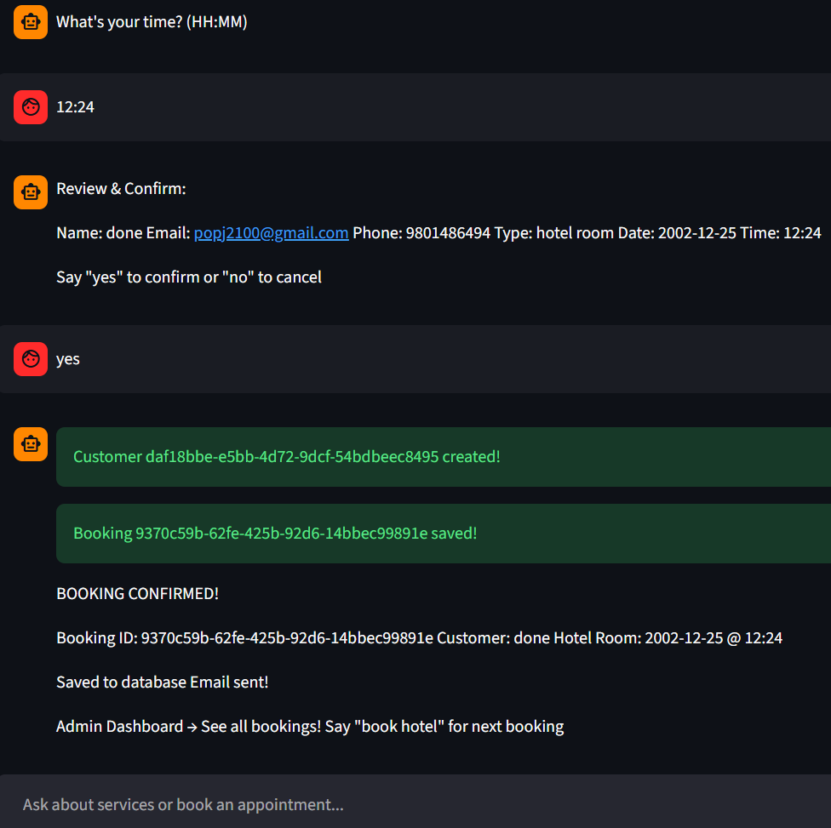
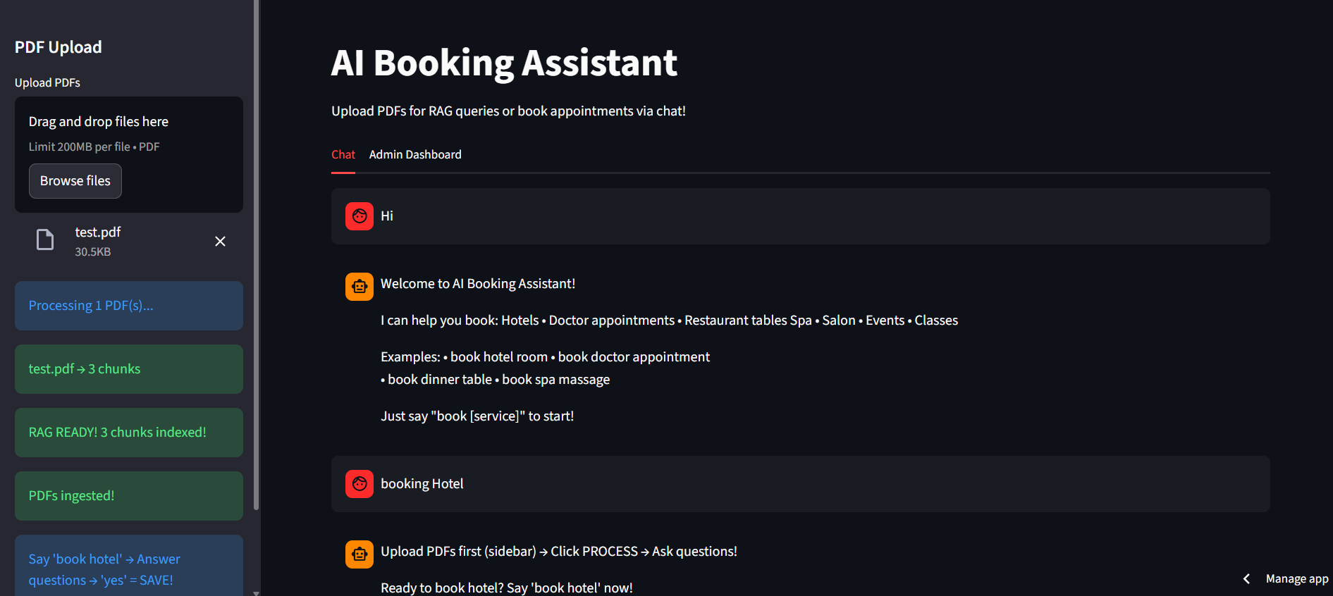
Screenshots: Chat Interface

Slide 10
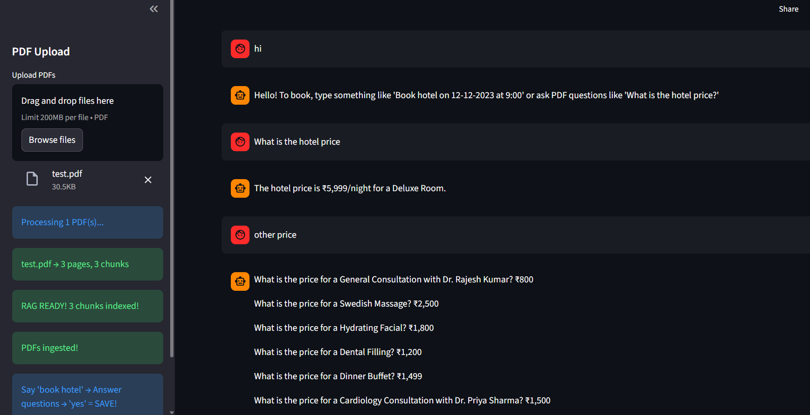
Screenshots: Chat Interface With RAG Use Case

Slide 11
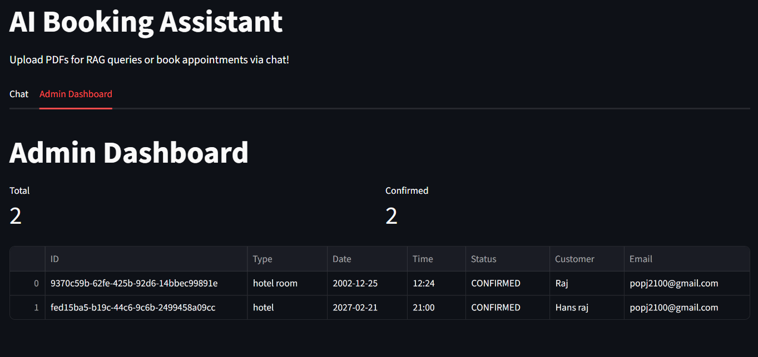
Screenshots: Admin Dashboard

Slide 12
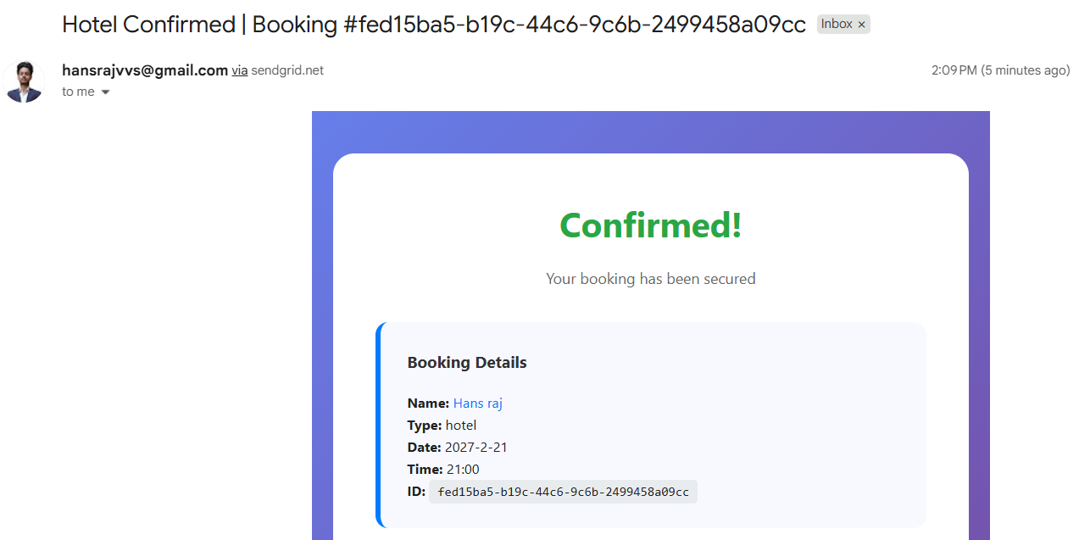
Screenshots: Email - Sendgrid

Slide 13
Challenges Faced
RAG Pipeline Complexity: Vector DB integration & retrieval accuracy
State Management: Maintaining booking state across multi-turn conversations
API Integration: Coordinating Groq, SendGrid, Supabase APIs
Error Handling: Graceful fallbacks when services unavailable

Slide 14
Solutions & Lessons Learned
Try-Catch Blocks: Prevented crashes from API failures
Session State: Used Streamlit's session_state for persistence
Intent Detection: Simple keyword matching + RAG fallback strategy
Testing: Mock data for development, zero-dependency fallback mode

Slide 15
Future Improvements
Multi-Language Support: Hindi, Tamil, Telugu, Kannada
Payment Integration: Razorpay for online payments
Mobile App: React Native or Flutter version
Advanced Analytics: ML-based demand forecasting
Real-time Availability: Live slot synchronization with providers

Slide 16
Deployment & Scalability
Docker Containerization: Consistent deployment across environments
Cloud Platforms: Streamlit
Database Scaling: Supabase auto-scaling PostgreSQL
API Rate Limiting: Groq & SendGrid quota management
GitHub repo : https://github.com/HansrajS1/AI-Booking-Assistant
Demo link: https://ai-booking-assistant.streamlit.app/

Slide 17
Key Takeaways
Intelligent conversational booking system
End-to-end data persistence & notifications
Admin dashboard for analytics & management
Production-ready, containerized, scalable

Slide 18
Thank You!
Questions?
GitHub: https://github.com/HansrajS1/AI-Booking-Assistant
Email: hansrajvvs@gmail.com

